Slide 1

Notes:
1st slide (Mandatory)

Slide 2
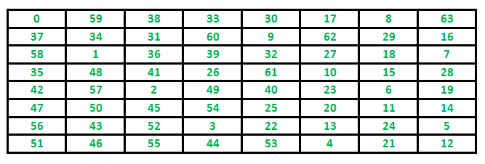

Warnsdorff ’s Algorithm
Definition
Warnsdorff's rule is a heuristic for finding a single knight's tour.
The knight is moved so that it always proceeds to the square from which the knight will have the fewest onward moves.
When calculating the number of onward moves for each candidate square, we do not count moves that revisit any square already visited.
Example :

Slide 3
Warnsdorff’s Algorithm –Knight’s Tour Problem
import java.util.concurrent.ThreadLocalRandom;
class GFG{
public static final int N = 8;
public static final int cx[] = {1, 1, 2, 2, -1, -1, -2, -2};
public static final int cy[] = {2, -2, 1, -1, 2, -2, 1, -1};
boolean limits(int x, int y) {
return ((x >= 0 && y >= 0) &&
(x < N && y < N));
}
boolean isempty(int a[], int x, int y) {
return (limits(x, y)) && (a[y * N + x] < 0);
}
int getDegree(int a[], int x, int y) {
int count = 0;
for (int i = 0; i < N; ++i)
if (isempty(a, (x + cx[i]),
(y + cy[i])))
count++;
return count; }
Cell nextMove(int a[], Cell cell) {
int min_deg_idx = -1, c,
min_deg = (N + 1), nx, ny;
int start = ThreadLocalRandom.current().nextInt(1000) % N;
for (int count = 0; count < N; ++count) {

Slide 4
Warnsdorff’s Algorithm –Knight’s Tour Problem
int i = (start + count) % N;
nx = cell.x + cx[i];
ny = cell.y + cy[i];
if ((isempty(a, nx, ny)) &&
(c = getDegree(a, nx, ny)) < min_deg)
{
min_deg_idx = i;
min_deg = c; } }
if (min_deg_idx == -1)
return null;
nx = cell.x + cx[min_deg_idx];
ny = cell.y + cy[min_deg_idx];
a[ny * N + nx] = a[(cell.y) * N +
(cell.x)] + 1;
cell.x = nx;
cell.y = ny;
return cell; }
void print(int a[]) {
for (int i = 0; i < N; ++i) {
for (int j = 0; j < N; ++j)
System.out.printf("%d\t", a[j * N + i]);
System.out.printf("\n"); } }
boolean neighbour(int x, int y, int xx, int yy) {
for (int i = 0; i < N; ++i)
if (((x + cx[i]) == xx) &&
((y + cy[i]) == yy))
return true;
return false; }
boolean findClosedTour() {
// Filling up the chessboard matrix with -1's
int a[] = new int[N * N];
for (int i = 0; i < N * N; ++i)
a[i] = -1;

Slide 5
while (!new GFG().findClosedTour()) {
;
} } }
class Cell{
int x;
int y
public Cell(int x, int y){
this.x = x;
this.y = y; }
}
int sx = 3;
int sy = 2;
Cell cell = new Cell(sx, sy);
a[cell.y * N + cell.x] = 1; // Mark first move.
Cell ret = null;
for (int i = 0; i < N * N - 1; ++i) {
ret = nextMove(a, cell);
if (ret == null)
return false; } if (!neighbour(ret.x, ret.y, sx, sy))
return false;
print(a);
return true; }
public static void main(String[] args) {
Output:
59 14 63 32 1 16 19 34
62 31 60 15 56 33 2 17
13 58 55 64 49 18 35 20
30 61 42 57 54 51 40 3
43 12 53 50 41 48 21 36
26 29 44 47 52 39 4 7
11 46 27 24 9 6 37 22
28 25 10 45 38 23 8 5

Slide 6

THANK YOU

